Slide 1
Commercial Management
of
Mid and Back Offices
April 2001
Offsite Presentation

Slide 2
Agenda
Overview
Service Offering
Market
New Structure
Risks and Mitigants
Services and Processes
Next Steps

Slide 3
Overview
Opportunity | ENE | Market
What? | Using an application service provider model, ENW will perform mid and back office services for third party customers | Use Enron’s service vs. build or buy and maintain infrastructure
Why? | Enron has a best-in-class system that can be commercialized to provide additional opportunities for originators and increased profits for Enron | World class system available Stay current with technology Reduce development risk Free to concentrate on core business

Slide 4
Overview
Opportunity | ENE | Market
Who? | ENA gas and power originators ENW originators ENW subject matter experts | Marketers Producers LDCs Buyers Brokers Govt. / Municipal
Where? | Service supported at present location within Enron. | Services accessed via manual entry or electronic medium with minimal implementation expense

Slide 5
Overview
Opportunity | ENE | Market
How? | Originators supported by operations desk, subject matter experts and customer service personnel will utilize new and existing sales channels to serve target market. | Relate needs to ENE origination team Sign service level agreement
When? | Service available immediately Operations desk, DASH and service level agreements ready soon | Limited number of customers currently served

Slide 6
What are the Services?
Initially, services offered will include:
  Deal capture and confirmation services
  Position reporting
  Logistics and scheduling services
  Volume management
  Settlements (cash collection / payment and reconciliation)
  AR/AP accounting entries
Future offerings will include other bundled services, e.g. risk reporting , etc.

Slide 7
Overview of Services and Processes
Deal Data
1. Deal Capture
/ Set up
Confirmed Deal Data
3. Logistics
(Scheduling
and
Nominations)
Customers
Confirmed Deal Data
Deal Data Nominations
Validated Deal Data
2. Deal
Confirmation
4. Volume
Management
(Balancing)
5. Settlements
Updated Deal Data

Slide 8
What Commodity Types are Supported?
Initial mid and back-office services for third party customers will support:
  Physical gas
  Financial gas
  Financial power
More product-types will be supported in the future

Slide 9
Why this Service and Why Now?
Monetization opportunity brought about by:
  Our scalable, best-in-class system which has allowed cost per transaction to remain relatively flat while transactions have increased
(New graph showing transactions increase and cost/txn stable)

Slide 10
Market Opportunity
The addressable market size was derived by extrapolation from EnronOnline Transaction volumes
Assumptions: Transaction Volume
Gas Physical
Gas Financial
Power
Phys. & Finc.
Current Annual ENE transaction count | 441,000 | 312,000 | 195,000
ENE Share of Market | 15% | 15% | 18%
Total Annual transaction count | 2,940,000 | 2,080,000 | 1,083,333
Est. Variable Cost per transaction | $61 | $17 | $15
Est.Fixed Cost per Top 20 Cos. * | $7,600,000
Est. Fixed Cost per next 80 Cos. * | $400,000
Est. Fixed Cost per next 400 Cos. * | $10,000
Total U.S. market size | $419,150,000
* Note: Fixed costs were estimated based on ENE’s $15 MM fixed expense allocation. Competitors were expected to spend less nominally than ENE because of its leadership in the industry, but more on a per transaction basis due to greater inefficiencies.

Slide 11
Market Segmentation
Number of Companies in Current Market Segments:
Company Type | Gas | Power
Marketers | 843 | 266
Producers | 799 | 140
Large Buyers | 496 | 116
LDCs | 278 | 0
Brokers | 145 | 78
Govt. / Municipal | 0 (?) | 544
Total | 2,561 | 1,144
Future Market Segments: Other commodity types, i.e. metals, crude, etc.
Data Source: OPIS Directories

Slide 12
Positioning
Approach to the target market:
  Concentrate on that which is core to your operation
  Best-in-class system
  Keep up with changing technology
    – upgrade as Enron upgrades
  No maintenance or infrastructure expenses
  Reduce development risk
Notes:
Approach to market
Pitch
Service Level Agreements
Pricing Methodology

Slide 13
Marketing the Services
Service level agreement:
  (Points to be filled in as they are determined)
Notes:
Approach to market
Pitch
Service Level Agreements
Pricing Methodology

Slide 14
How will Origination Work?
Originators
(ENA & ENW)
Back Office = Commercial
  Pricing comes from a desk
Multiple distribution channels:
  ENA Originators : existing relationships
  ENW Originators : New / Direct relationships and business development
Distribution channels will work with domain experts toward closing the deal
BO
Desk
Notes:
Originators will market the services to customers.
Originators will get pricing from a desk before serving prices to a customer.
ENE systems support personnel will continue to support the back office systems.
EnronOnline help desk will provide support for customers.

Slide 15
How will Support Work?
Two levels of customer service support:
  Level I: EnronOnline Help Desk
  Level II: Enron Operation Services
Notes:
Originators will market the services to customers.
Originators will get pricing from a desk before serving prices to a customer.
ENE systems support personnel will continue to support the back office systems.
EnronOnline help desk will provide support for customers.

Slide 16
New Structure – What has Changed?
 | Process | Benefits of Change
Before | Deals done without pricing from operations desk Services offered without sign-on Services offered without energy operation’s knowledge or buy-in
Now | Deals with an operations component require pricing from operations desk and signed DASH Stand-alone services deals will require pricing from operations desk and signed DASH | Control of deal profitability Increased level of service Coordinated approach to the marketplace
Notes:
Originators will market the services to customers.
Originators will get pricing from a desk before serving prices to a customer.
ENE systems support personnel will continue to support the back office systems.
EnronOnline help desk will provide support for customers.

Slide 17
Steps in Structuring a Deal
Identify customer needs
Work with domain experts from operations desk to ensure deal compliance
Determine deal terms and specifications with domain experts and customers
Receive offers from desk
DASH signed by ENE management
Contract
Notes:
Originators will market the services to customers.
Originators will get pricing from a desk before serving prices to a customer.
ENE systems support personnel will continue to support the back office systems.
EnronOnline help desk will provide support for customers.

Slide 18
Overview of the Operations Desk
Factors affecting mid & back office pricing:
Operationally intensive transactions
Gas asset management deals
Originated and structured deals
New and renewed deals
Cost analysis of mid & back office:
Process cost analysis
Activity cost analysis
Efficiency & productivity analysis
Trend analysis
Impact analysis
Enron Americas
Natural Gas
Power
US and Canada
EGM
Crude / Products
LNG
Coal
Emissions
Weather
EIM
Pulp & Paper
Lumber
Steel
EEL
Present
Future
Notes:
Originators will market the services to customers.
Originators will get pricing from a desk before serving prices to a customer.
ENE systems support personnel will continue to support the back office systems.
EnronOnline help desk will provide support for customers.

Slide 19
How will the Operations Desk Work?
Deal Data
Customer
Back Office
Services
Operations
Desk
Needs
Offer + margin
Deals
Originator
Offer
Back Office Desk controls pricing levels
Originators receive an offer price
Keep excess over offer price
Charged back for selling under offer price

Slide 20
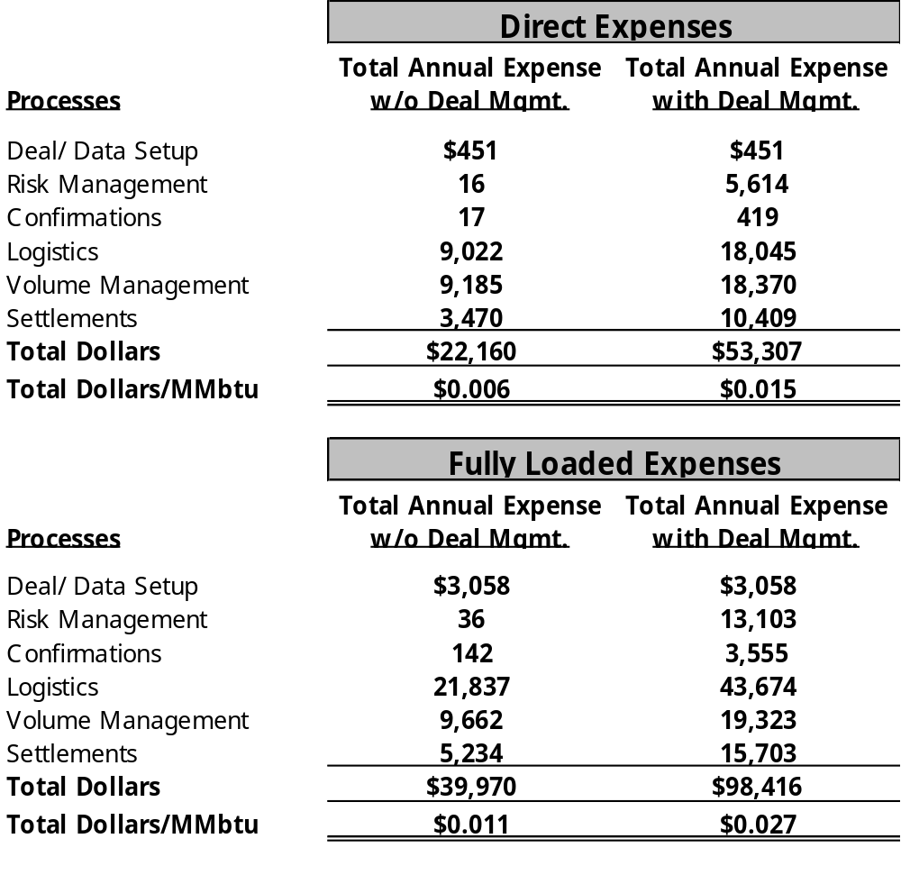
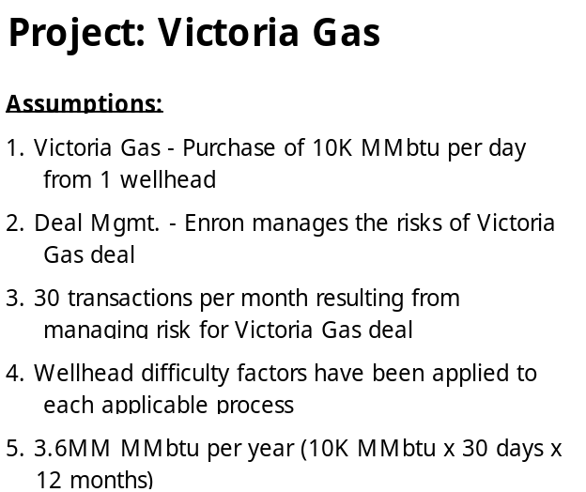
Operations Desk Pricing Example : Victoria Gas
Small to Average
Size Deal

Slide 21
Risks and Mitigants
Process | Risks | Mitigants
Deal Set up | Set up data incorrectly | Deal Confirmation
Deal Capture | Capture data incorrectly | Deal Confirmation
Deal Confirmation | Errors not identified | Proceed only after receiving confirmation acceptance
Logistics | Mis-nominate | Communicate in writing to customers
Volume Management | Mis-communicate volume discrepancies | Resolve discrepancies within customer-give parameters
Settlements | Over or under pay customers | Adhere to checks and balances currently in operation
Records Retention | Incomplete records available for audits and arbitration | Store physical and electronic copies

Slide 22
Overview of Services and Processes
Deal Data
1. Deal Capture
Confirmed Deal Data
3. Logistics
(Scheduling
and
Nominations)
Customers
Confirmed Deal Data
Deal Data Nominations
Validated Deal Data
2. Deal
Confirmation
4. Volume
Management
(Balancing)
5. Settlements
Updated Deal Data

Slide 23
Step 1: Deal Capture
Deal Data
1. Deal Capture
Confirmed Deal Data
3. Logistics
(Scheduling
and
Nominations)
Customers
Confirmed Deal Data
Deal Data Nominations
Validated Deal Data
2. Deal
Confirmation
4. Volume
Management
(Balancing)
5. Settlements
Updated Deal Data

Slide 24
Step 1(a): Deal Capture
Objective: Capture Deal Information
Sitara, TAGG,
EnPower
Deal Capture
Customers
Process:
ENW will accept deal data via:
Electronic mediums
Direct entry by customer
Fax
Technology:
Sitara captures deal data for term and spot physical gas transactions for scheduling purposes.
TAGG captures financial and term physical deal data for gas transactions for valuation / risk books.
EnPower / Deal blotter captures deal data for physical and financial power transactions.
Notes:
Three deal capture systems required?
Physical gas makes it’s way into TAGG from Sitara for valuation purposes.
Thunderball will replace TAGG as a trade capture system.

Slide 25
Step 1(b): Deal Capture - Validation
Objective: Validate Deal Information
1. Sitara, TAGG,
EnPower
Deal Capture
2. Global Data
Counterparty
Facilities
Contracts
Common Codes
3. UNIFY
MOPS
Customers
Deal Data
Deal Validation
Contract and Meter Data
Process:
Deal data is validated against existing counterparty, facilities and contracts information.
The validated deal data is sent back to deal capture and to the pipeline.
Technology:
Global Counterparty tracks customer-specific information, (i.e. address and bank).
Global Facilities provides facility information, (i.e. zone, meter number).
Global Contracts houses contract-specific information for each customer, (i.e. contract type, termination dates and contract status).
Common Codes provides terms used in multiple applications to ensure consistent use across them.
Marketing Operations System (MOPS) resides within Unify and tracks revenue transportation and storage volumetric activities.

Slide 26
Step 2: Deal Confirmation
Deal Data
1. Deal Capture
Confirmed Deal Data
3. Logistics
(Scheduling
and
Nominations)
Customers
Confirmed Deal Data
Deal Data Nominations
Validated Deal Data
2. Deal
Confirmation
4. Volume
Management
(Balancing)
5. Settlements
Updated Deal Data

Slide 27
Step 2: Deal Confirmation
Objective: Verify Deal Points with Customer
1. Sitara, TAGG,
EnPower
Deal
Capture
Validated Deal Data
2. Deal
Confirmation
3. Settlements
DCAF, DCAF II
Fax Confirmation
Verbal Confirmation
Customer /
Counterparties
Process:
Deal confirmation receives validated deal data from deal capture.
Verbally confirm deal with customer / counterparties.
Create confirmation and fax to customer / counterparty.
Monitor confirms for execution and/or changes.
Resolve any changes and resend confirmation.
Electronically archive copy of confirmation.
Technology:
Sitara, TAGG or EnPower provide validated deal information to DCAF (see below).
Deal Confirmation Auto Fax (DCAF) is used to prepare, fax and archive deal confirmation.
  DCAF is used to create and fax confirms for all financial and term physical transactions
  DCAF II is used to create and fax confirms for spot physical transactions.
Livelink can also be used to archive documents.

Slide 28
Step 3: Logistics (Scheduling and Nominations)
Deal Data
1. Deal Capture
Confirmed Deal Data
3. Logistics
(Scheduling
and
Nominations)
3rd party banks
Customers
Confirmed Deal Data
Invoice / Cash
Deal Data Nominations
Validated Deal Data
2. Deal
Confirmation
4. Volume
Management
(Balancing)
5. Settlements
Updated Deal Data

Slide 29
Step 3: Logistics (Scheduling and Nominations)
Objective: Manage transportation of physical gas per deal data
1. Sitara
Deal Capture
2. Unify
MOPS
Nominated & Confirmed Volumes
Updated Volumes
3. Pipeline(s)
Bridge
EDI
Hub
Nomination Information
Allocated Volumes
Process:
Receive deal information.
Prepare nominations in system.
Monitor system for position accuracy.
Manage physical position on all pipelines at all trading locations.
Path market and supply deals in system.
Communicate pipeline-specific information to customers / counterparties.
Create and send nominations to pipeline.
Confirm gas scheduled per nomination.
Communicate nomination discrepancies.
Re-confirm and re-nominate as necessary.
Receive invoices from pipelines.
Technology:
Sitara passes deal information to MOPS.
MOPS houses transportation rates and communicates nominations and confirmed pipeline volumes to pipelines.

Slide 30
Step 4: Volume Management
Deal Data
1. Deal Capture
Confirmed Deal Data
3. Logistics
(Scheduling
and
Nominations)
3rd party banks
Customers
Confirmed Deal Data
Invoice / Cash
Deal Data Nominations
Validated Deal Data
2. Deal
Confirmation
4. Volume
Management
(Balancing)
5. Settlements
Updated Deal Data

Slide 31
Step 4: Volume Management
Objective: “Actualize” (Reconcile) allocated vs. nominated volumes per deal data.
2(a). Unify
MOPS
Volume Mgt.
1. Counterparty
Actualized transaction data
3. Settlements
Quantity Information
Discrepancy?
Meter Allocation Information
2(b). POPS
Y
N
Process:
Receive counterparty’s pipeline statements.
Process quantity information and synchronize pipeline information.
Obtain allocations of the meters.
Communicate volume discrepancies.
Perform and communicate reconciliation of discrepancies.
Technology:
MOPS provides meter allocation data, received from third party pipelines.
The Pipeline Operations System (POPS) provides this information from HPL & LRC pipelines & storage.
Volume Management allows the actualization of these volumes.

Slide 32
Step 5: Settlements
Deal Data
1. Deal Capture
Confirmed Deal Data
3. Logistics
(Scheduling
and
Nominations)
3rd party banks
Customers
Confirmed Deal Data
Invoice / Cash
Deal Data Nominations
Validated Deal Data
2. Deal
Confirmation
4. Volume
Management
(Balancing)
5. Settlements
Updated Deal Data

Slide 33

Step 5(a): Settlements - Invoicing
Objective: Create & send accurate and timely invoices.
1. Rates Server
Rates
3. Counterparties
Price Updates
Index Values
Reports
2. Unify
Settlements
MOPS
Unify Tables
Volume Mgt.
Verified?
Y
End
Invoices
N
Process:
Receive notice that prices have been updated.
Generate settlements schedules.
Create invoices from schedules.
Reconcile discrepancies.
Update deal capture system when reconciled.
Send invoice to Settlements or counterparties.
Technology:
The Rates Server receives external commodity rates from third party sources and passes them on to Unify.
The Settlements application within Unify generates settlement schedules and invoices.

Slide 34

Step 5(b): Settlements - Accounting
Objective: Settle transactions with counterparties and generate accounting entries for client.
Unify
Settlements
MOPS
Unify Tables
Volume Mgt.
SAP
Invoices
Y
Cash Flow
Transactions
Verified?
N
Counterparties
Process:
Confirm that invoice has been verified by customer / counterparty.
Review invoice.
Confirm invoice
Batch and preload invoices. Make available to third party GL and internal purchase payable systems.
Report/resolve any errors.
Send wire transfers for outgoing payments.
Execute reports detailing outstanding receivables and payables.
Technology:
UNIFY’s Settlements application creates a settlements schedule and invoice.
SAP performs cash application duties.

Slide 35
Next Steps
Attain buy-in from relevant commercial teams.
Create an effective marketing plan.
3a. Complete service level agreement (SLA) template.
3b. Complete deal approval sheet (DASH) template.
Integrate commercialization of mid and back offices into the present structuring / origination / deal analysis process.

